Slide 1
STL2G
CNC MILL PROJECT
Fadi Hanna Al-Kass

Slide 2
Deliverables
*STL Syntax Validator.
*STL to G-Code Converter.

Slide 3
Languages Used
C Programming Language:
used to implement the STL syntax validation tool.
Perl
Used to implement Slic3r.
Python
Used to execute the syntax validator and Slic3r in order.
All I/O is handled at this level.

Slide 4
Tools Used
Lexical Analyzer:
Tool used is lex (http://dinosaur.compilertools.net/lex).
Was used to tokenize the numerical values and keywords used in STL files.
Parser Generator:
Tool used is yacc (http://dinosaur.compilertools.net/yacc/).
Was used to create the grammar rules which the syntax of the STL file was checked against.

Slide 5
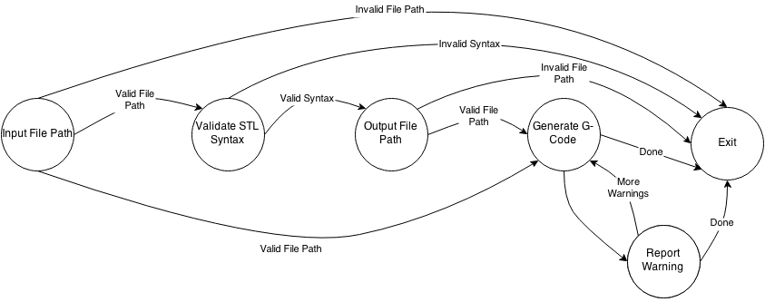

Slide 6
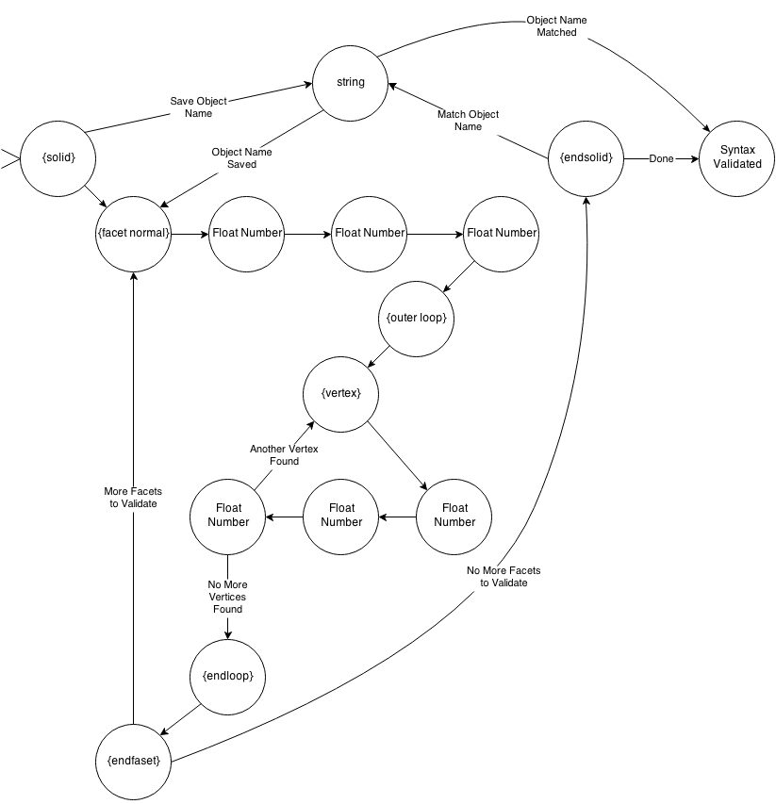

Slide 7
Version Control
All work done as well as work in progress can be accessed at
http://github.com/alkass/CNC-MILL

